Slide 1
CSC312
Automata Theory
Lecture # 2
Languages

Slide 2
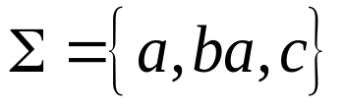
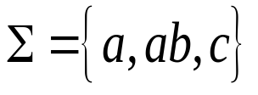
Alphabet and Strings
Alphabet: An alphabet is a finite set of symbols, usually letters, digits, and punctuations.
Valid/In-valid alphabets: An alphabet may contain letters consisting of group of symbols for example Σ= {a, ba, bab, d}.
Remarks: While defining an alphabet of letters consisting of more than one symbols, no letter should be started with the letter of the same alphabet i.e. one letter should not be the prefix of another. However, a letter may be ended in a letter of same alphabet.
    Valid alphabet :
    Invalid alphabet :

Slide 3
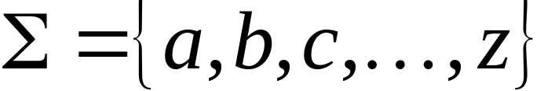
Alphabets and Strings
String or word: A finite sequence of letters/alphabets
Examples: “cat”, “dog”, “house”, “read” …
  Defined over an alphabet:
    Language: A language is a set of strings constructed from some alphabet e.g. Urdu, English, Java, the set of all binary strings

Slide 4
Sentences are made up of certain combinations of words.
Not all combinations of words lead to a valid English sentence.
So we see that some basic units are combined to make bigger units.

Slide 5
Languages
How can you tell whether a given sentence belongs to a particular languages
  Black is cat the
  The tea is hot
  I like chocolates two much
Rules give a clue to forming as well as validating sentences.

Slide 6
Formal vs. Informal Rules
Informal language -> abstract languages
Incoherent strings are also understandable
    Slang, idiom, dialect etc.
Raise ambiguity
  Interpretation varies with region
    I am through (BrE/AmE)
  Same words have multiple meanings.
    Like, light, base, etc.

Slide 7
Summary of Languages
Three aspects/specifications
  Lexical
    Defines valid words/units of a language
  Syntactic
    Defines rules for combining the units to form valid sentences (computer programs in context of machines)
  Semantic
    Concerned with the interpretation or meaning of a sentence (what output to produce in context of machines)
    Affected by ambiguity the most.

Slide 8
Formal languages
Rules defined explicitly and clearly
No ambiguities
Universally uniform understanding
Lets the machine
  Interpret an input uniformly every time. i.e. always produces same output for a particular input
  Avoid crashes because of ambiguity.
  Explicitly and categorically reject invalid input

Slide 9
Formal Languages
Need uniformly understandable notation
Representations
  Alphabet
    Represents a finite set of fundamental units of lanauges, e.g. for English ∑={a,b,….z.A,…Z,}
    ∑ = {0,1}
  ∑ = {0,1,2,3,4,5,6,7,8,9}

Slide 10
Formal Languages
  List of words
    Set of all valid words of a given language, e.g., a language English_Words that contains all valid words of English would have a  = {all entries of the dictionary + punctuation marks and blank space}
    Denoted by 
    Is  Finite or Infinite set.
Strings: A string a finite sequence of symbols chosen from alphabet. For example
  0111100 , 123045, abbbcdeg etc.

Slide 11
String Variable: A letter used for denoting a string. The author uses w, x, y and z as string variable. For example
  w = 0111100 , x = 123045, z = abbbcdeg
Length of String: The number of positions for symbols in the string. For simplicity we can say that it is the number of symbols in the string. For example
  |w| = 7 , |x| = ? , |z| = ?

Slide 12

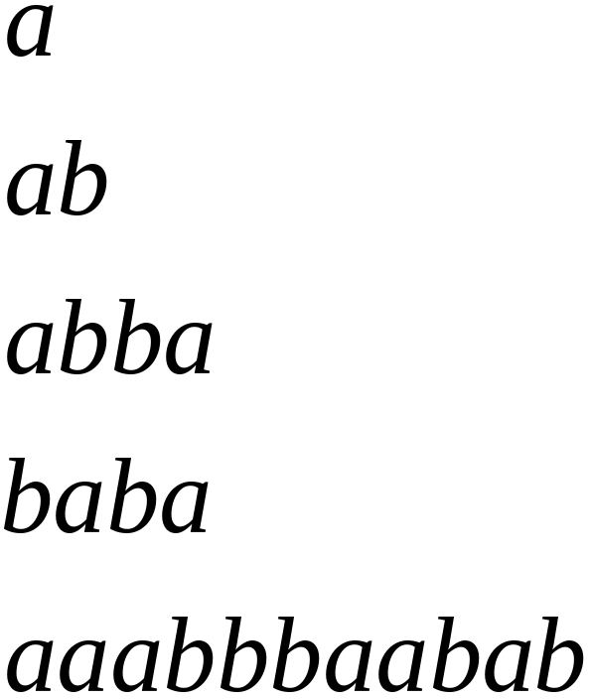
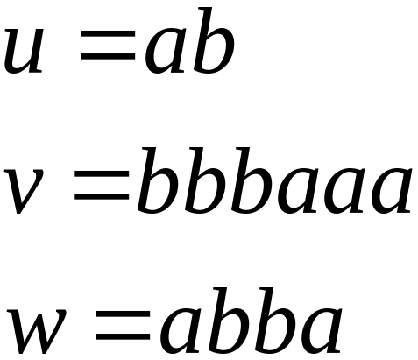
Alphabets and Strings
We will use small letters for alphabets:
Strings

Slide 13
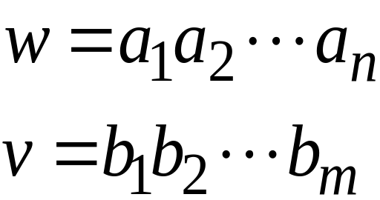
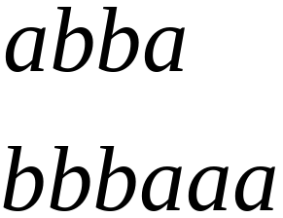
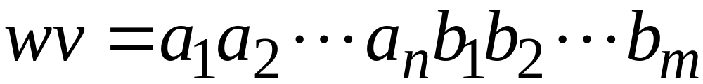


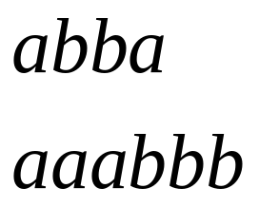
String Operations
Let we have following strings
Concatenation
Reverse

Slide 14



String Length
Length:
Examples:

Slide 15
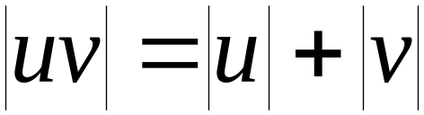

Length of Concatenation
Example:

Slide 16
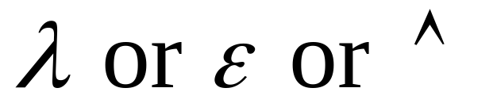
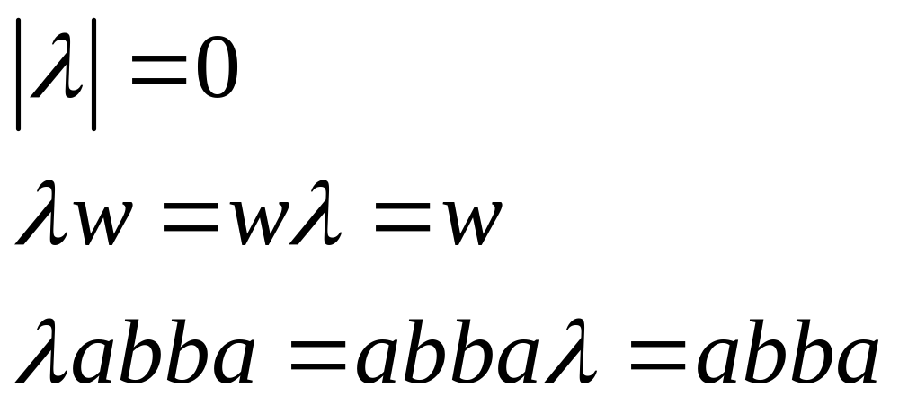
Empty String
A string with no letters:
Observations:
Note-1: A language that does not contain any word at all is denoted by φ or { }. This language doesn’t contain any word not even the NULL string. i.e. { } ≠ {λ}

Slide 17
Empty String
Note-2: Suppose a language L doesn’t contain NULL then
L = L + φ
but L ≠ L + {λ}.
Important : NULL is identity element with respect to concatenation.

Slide 18


Substring
Substring of string:
  a subsequence of consecutive characters
String Substring

Slide 19




Prefix and Suffix
Let the string is
Prefixes Suffixes
prefix
suffix

Slide 20
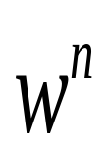




Repeat Operation
- w repeated n time; that is,
Example:
Definition:

Slide 21



The * Operation
: the set of all possible strings from
alphabet , called closure of alphabets also known as Kleene star operator or Kleene star closure.
i.e. infinitely many words each of finite length.

Slide 22


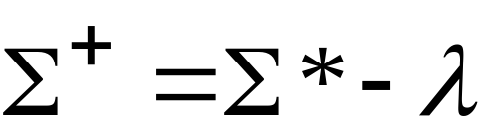
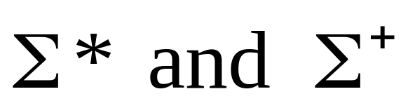
The + Operation
: the set of all possible strings from
alphabet except , also known as Kleene plus operator.
Note : are infinite

Slide 23

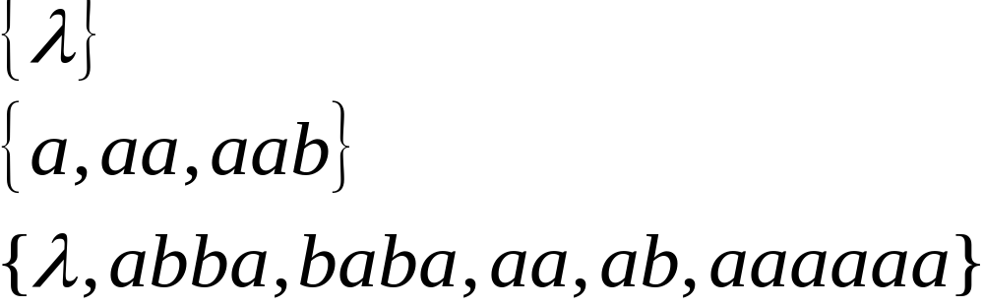
Languages
A language is a set of strings OR
A language is any subset of , usually denoted by L. It may be finite or infinite.
Example:
Languages:
If a string w is in L, we say that w is a sentence of L.

Slide 24
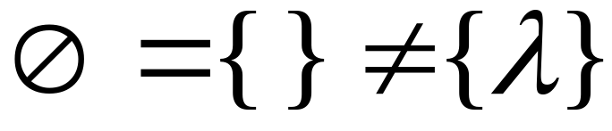



Note that:
Sets
Set size
Set size
String length

Slide 25




Another Example
An infinite language

Slide 26


Operations on Languages
The usual set operations
Complement:

Slide 27


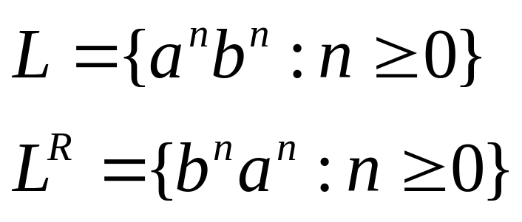
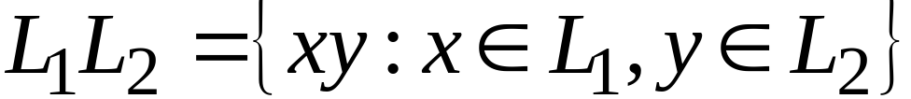
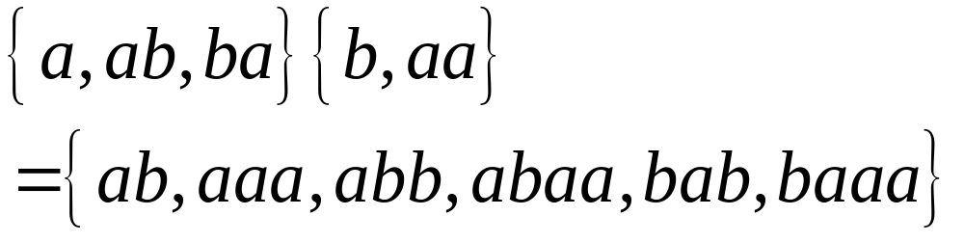
Reverse
Definition:
Examples:
Concatenation
Definition:
Examples:

Slide 28


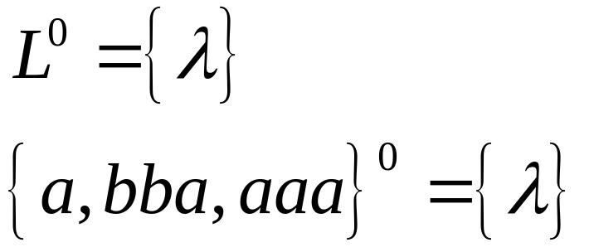
Repeat Operation
Definition:
L concatenated with itself n times.
Special case:

Slide 29



More Examples

Slide 30


Star-Closure (Kleene *)
Definition:
Example:

Slide 31
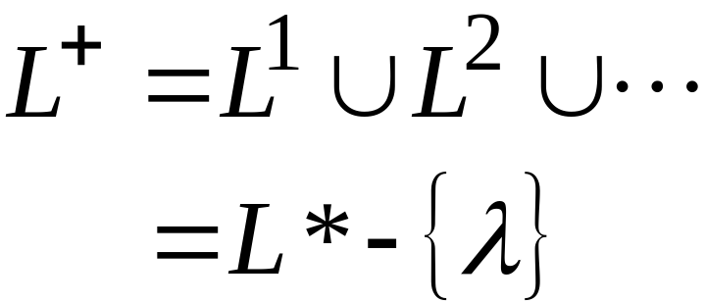

Positive Closure
Definition:
Note: L⁺ includes λ if and only if L includes λ

Slide 32

Lexicographical Order
Assume that the symbols in are themselves ordered.
Definition: A set of strings is in lexicographical order if
The strings are grouped first according to their length.
Then, within each group, the strings are ordered “alphabetically” according to the ordering of the symbols.

Slide 33
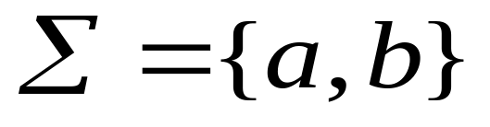
Lexicographical Order
Ex: Let the alphabet be
The set of all strings in Lexicographical order is
λ, a, b, aa, ab, ba, bb, aaa, …., bbb, aaaa, …, bbbb, ….

